Slide 1
INDEPENDENT PROJECT
Ama A. Agyeman Tuffour

Slide 2
RESEARCH QUESTIONS
How have constructions of cultural identity been impacted by colonization?
How does Kenya’s education system confront its colonial history?

Slide 3
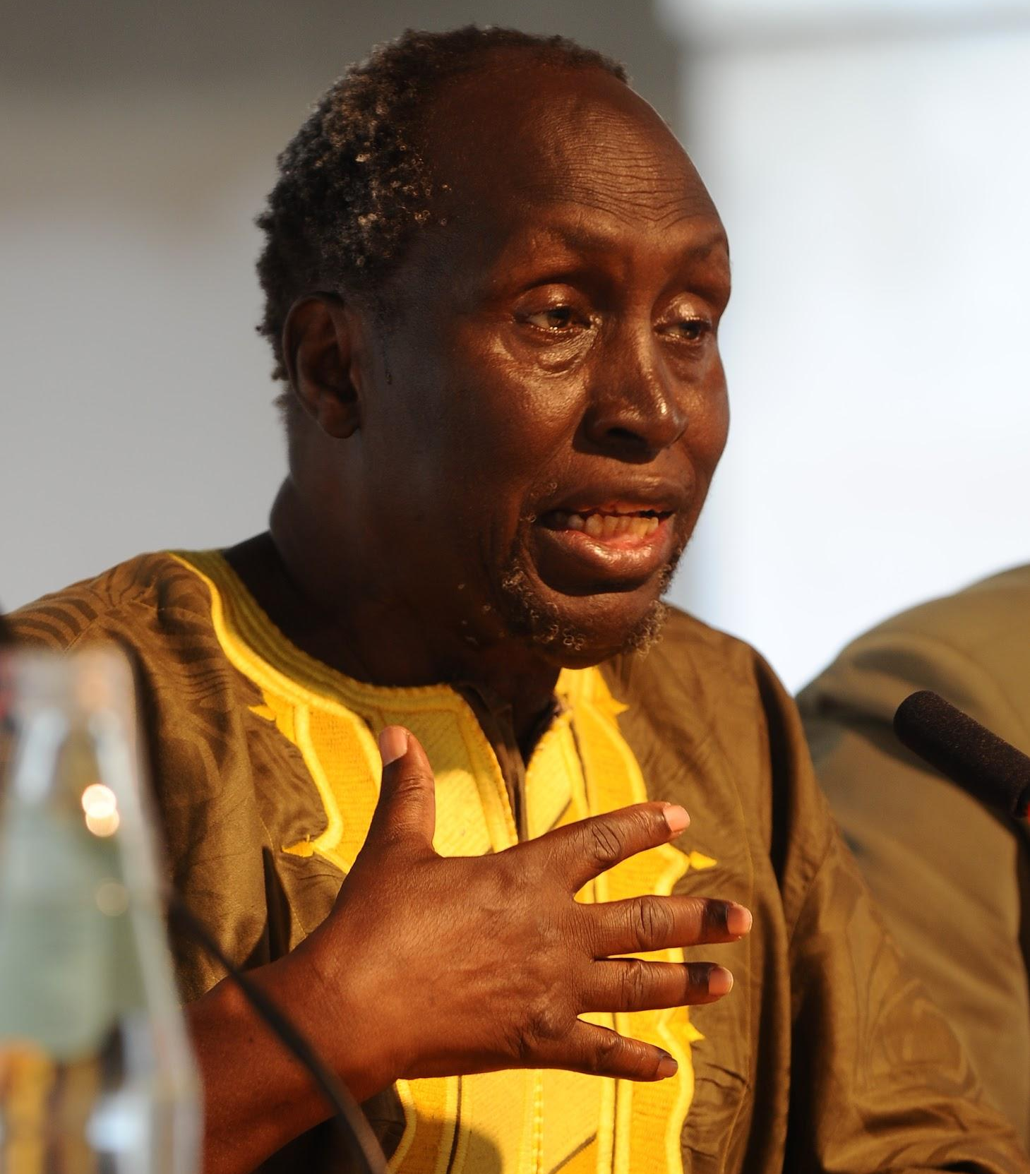
BACKGROUND
“Prior to independence, education in Kenya was an instrument of colonial policy designed to educate the people of Kenya into acceptance of their role as the colonized”
“But by our continuing to write in foreign [colonial] languages, paying homage to them, are we not on the cultural level continuing that neo-colonial slavish and cringing spirit?”

Slide 4
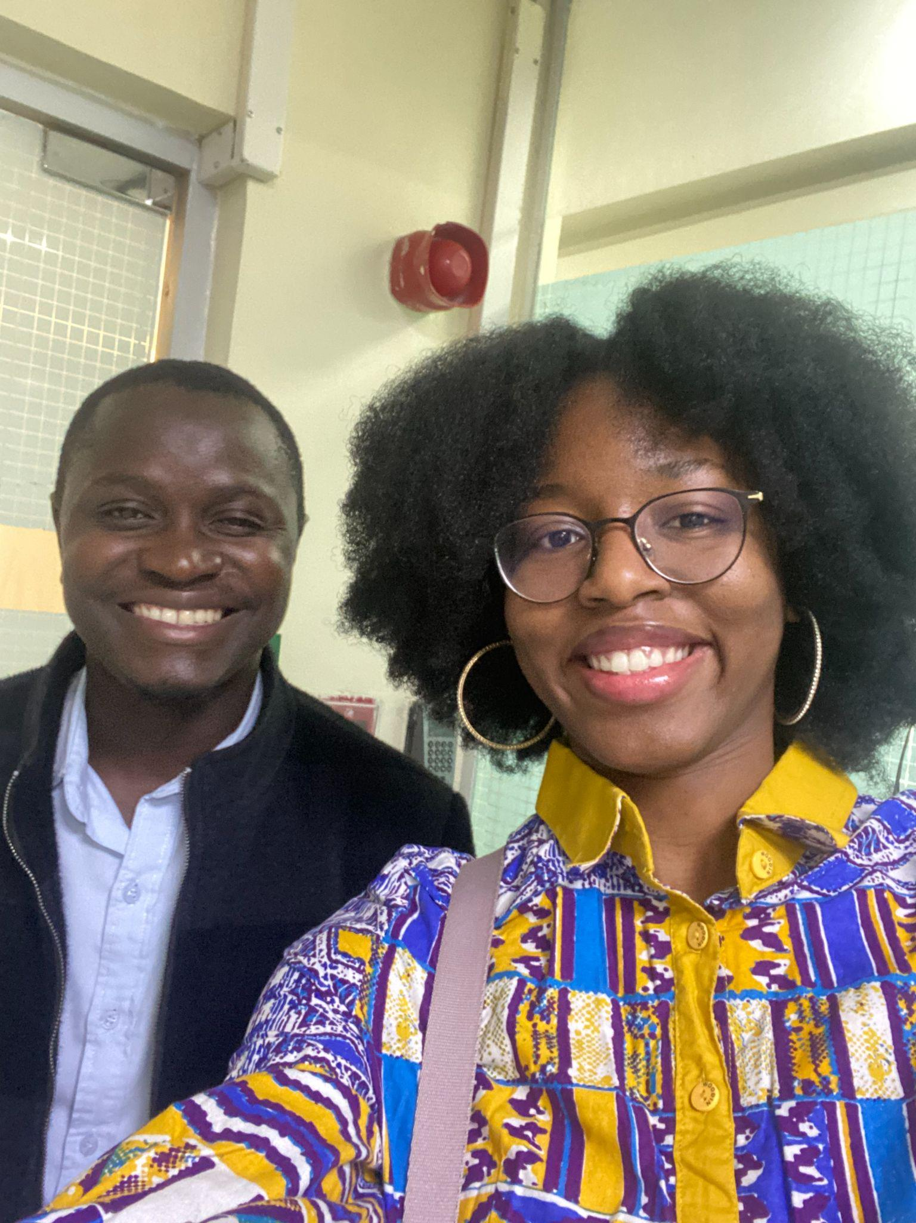

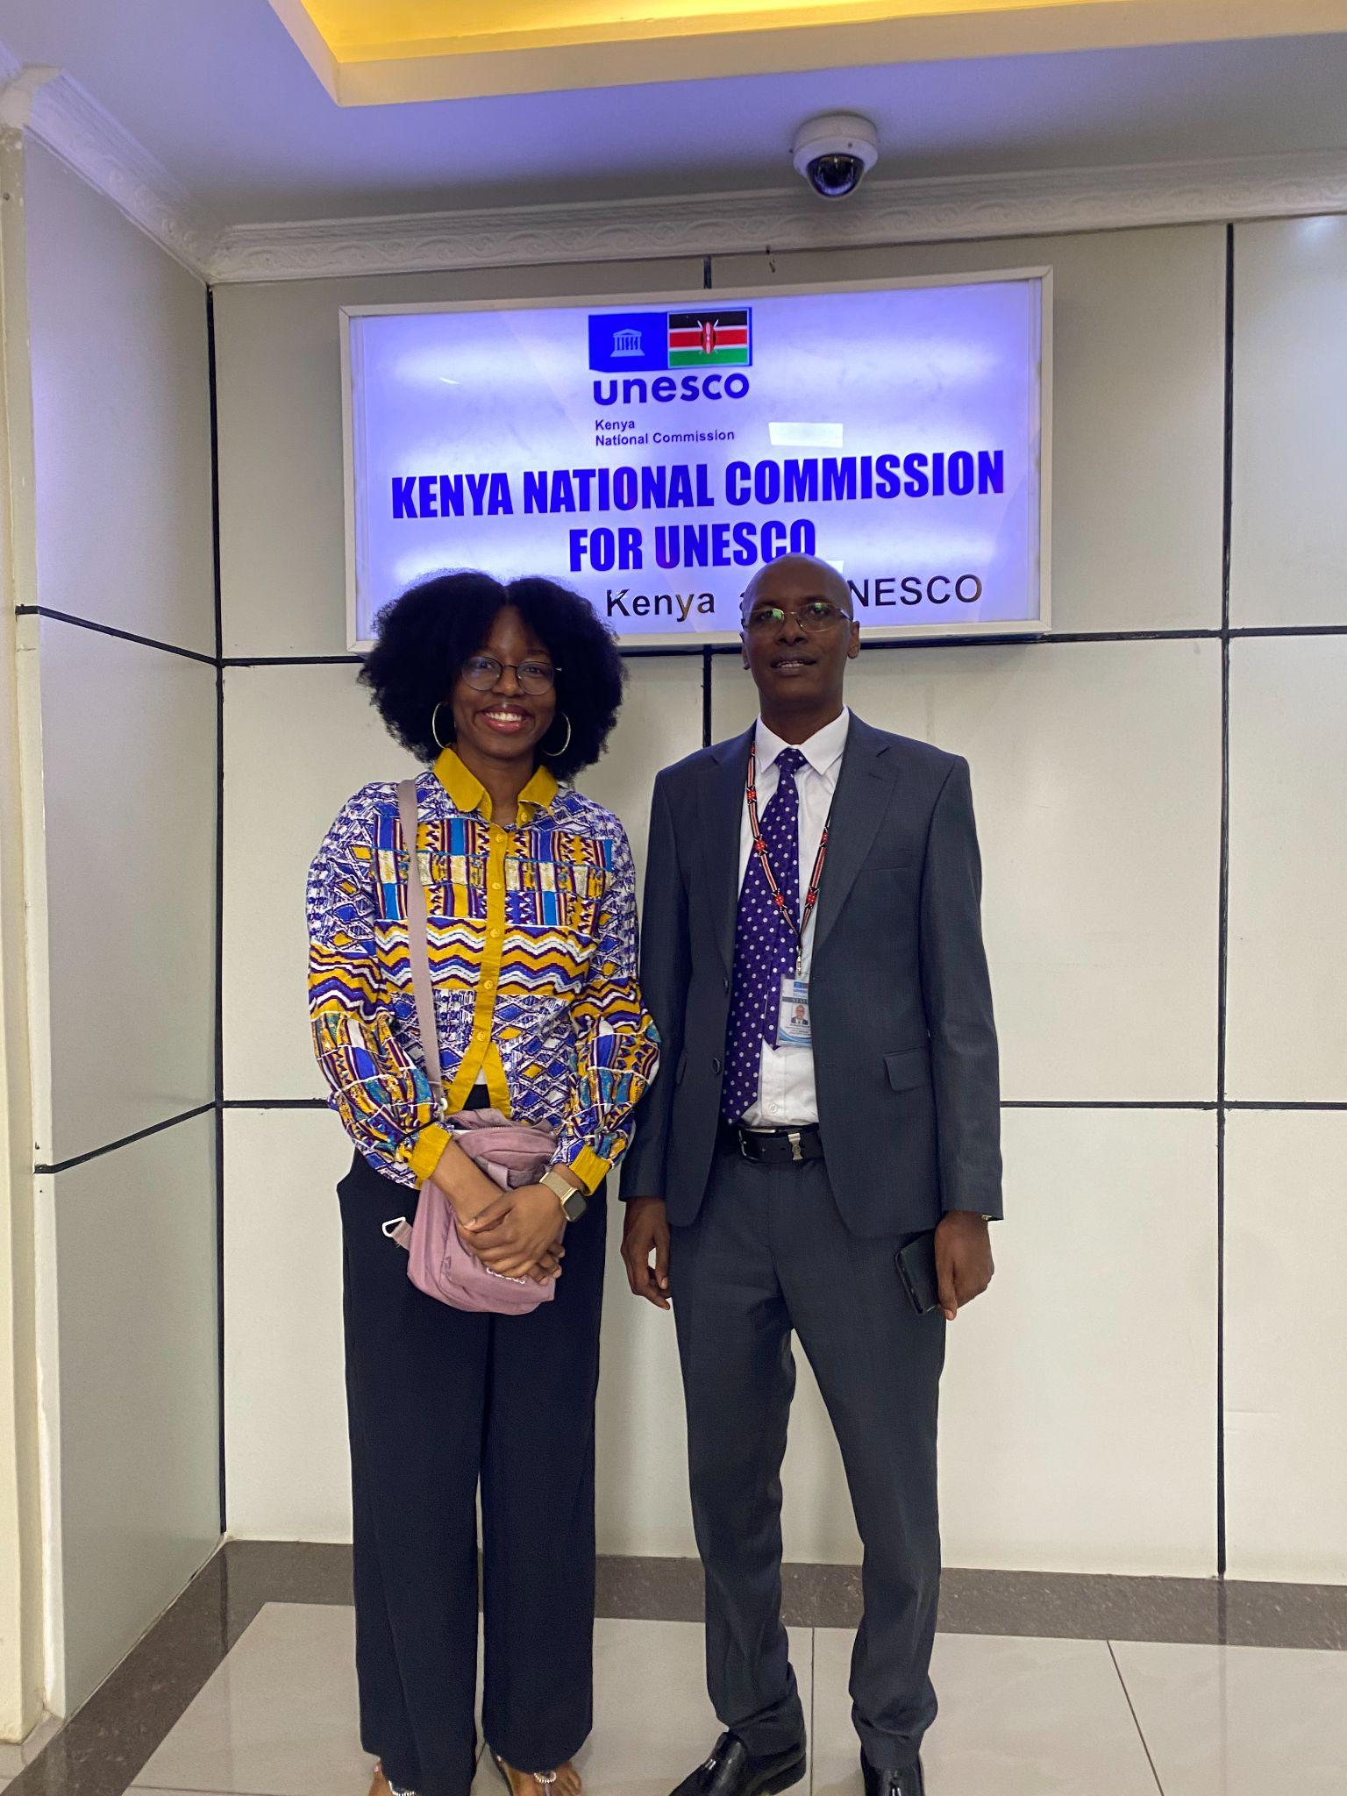

Slide 5
CONSTRUCTIONS OF PEACE
Defining peace as the absence of physical violence
This minimizes the gravity of other, more abstract manifestations of violece

Slide 6
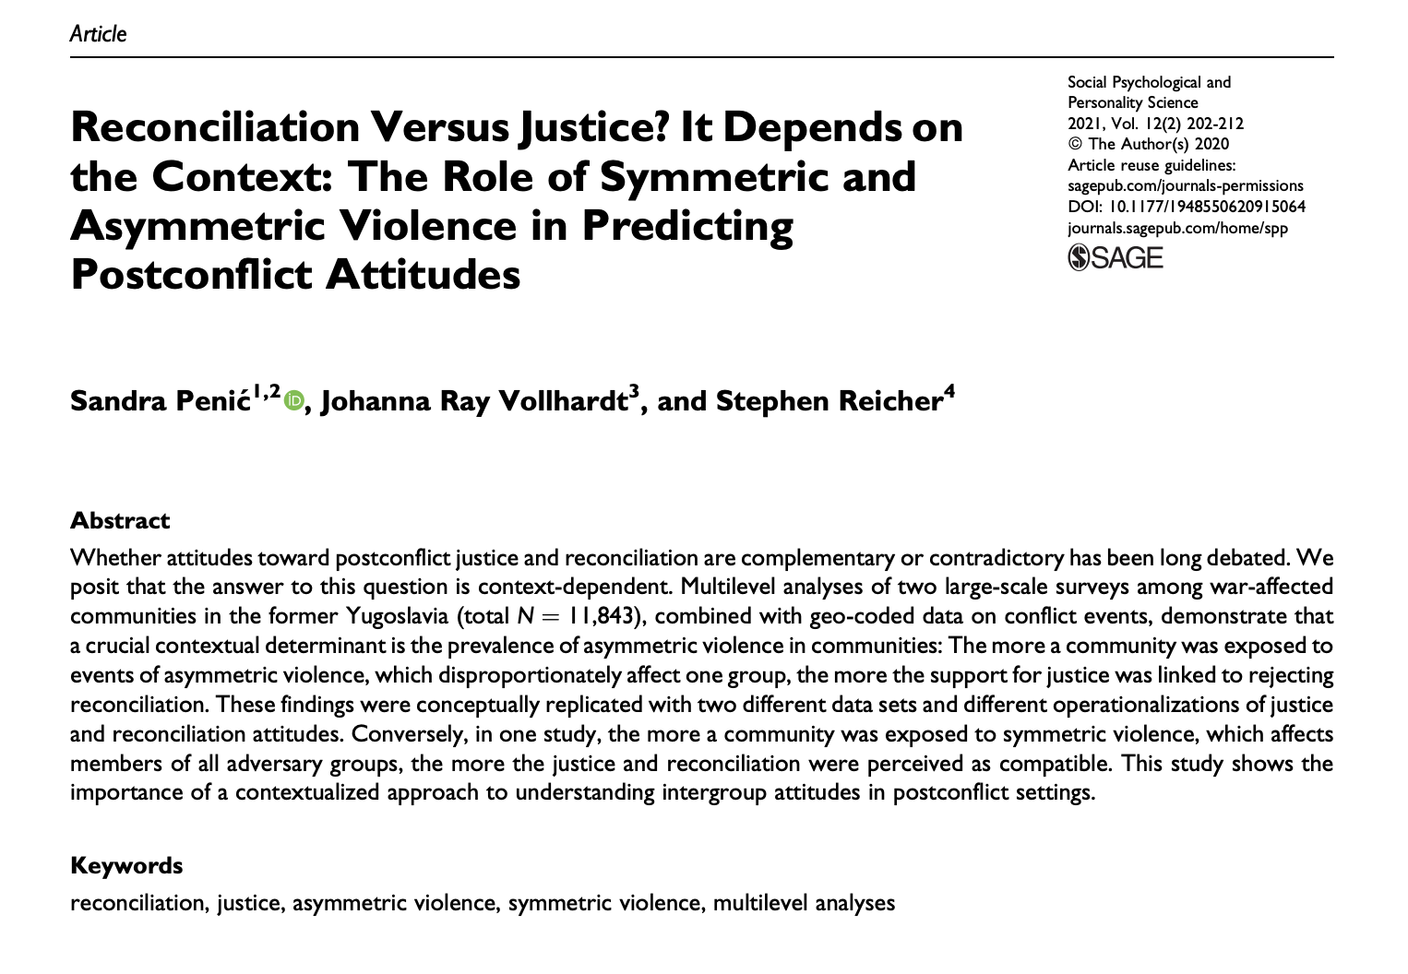

Slide 7
COMPARTMENTALIZING GLOBAL ISSUES
Viewing colonialism as separate from from other “more pertinent” world issues such as climate change, globalization etc.

Slide 8
TENSIONS
Reckoning with the conflation of misogyny with culture

Slide 9
TENSIONS
“In recent years, Kenya has witnessed a disturbing surge in cases of femicide… This rising tide of gender-based violence has sparked outrage, grief, and calls for urgent action across the nation… The epidemic of violence against women in Kenya is driven by a complex interplay of cultural,social, economic, and legal factors. Deep-seated patriarchal norms continue to foster gender inequalities, relegating women to subordinate roles and normalising domestic violence.” - National Gender and Equality Commission, Kenya

Slide 10

FUTURE DIRECTIONS
Building on the Marley Hypothesis to explore how our knowledge of colonial histories impacts our abilities to recognize modern day manifestations of colonialism
How does this translate into action?
  Missing third step

Slide 11
THANK YOU!
References
Penić, S., Vollhardt, J. R., & Reicher, S. (2021). Reconciliation versus justice? It depends on the context: The role of symmetric and asymmetric violence in predicting postconflict attitudes. Social Psychological and Personality Science, 12(2), 202-212.
National Gender and Equality Commission. (2026). Femicide in Kenya: Unmasking the epidemic of violence against women.

